Slide 1
Latent Semantic Analysis (LSA)
Some images and notes were retrieved from Datacamp.com, Hapke et. al Natural Language Processing in Action (2019), Applied Text Analysis with Python Bengfort et. al (2018), and StatQuest

Slide 2
Latent Semantic Analysis (LSA)
Previously, we have learnt
  how to generate count & tf-idf vectors,
  how to indicate importance of a token in a given document.
However, it may not be enough. We may also capture the meanings (semantics) of words.
What about the lemmatization process? Lemmatization keeps similarly spelled words together, but not necessarily words with similar meanings.
Additionally, lemmatization fails to pair up most synonyms. Synonyms usually differ in more ways than just the word endings, therefore lemmatization and stemming cannot deal with this situation.
Last but not least, lemmatization and stemming sometimes pairs up some words with opposite meanings.

Slide 3
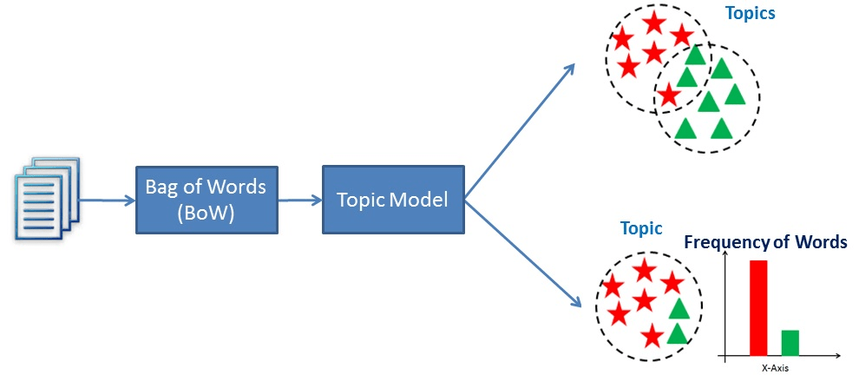
Latent Semantic Analysis (Topic Modeling)
Topic modeling means extracting hidden themes from given documents.

Slide 4
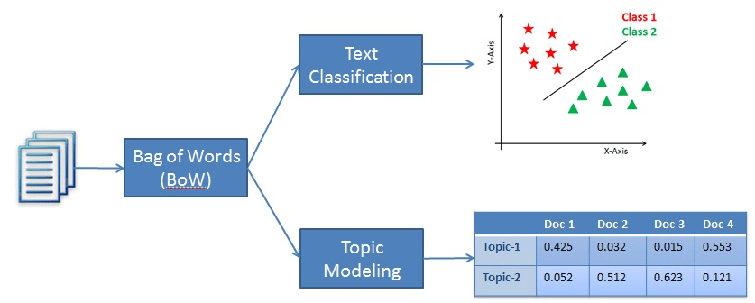
Latent Semantic Analysis (Topic Modeling)
We want to create compact vectors to indicate
  word-topic relationship
  document-topic relationship
And we expect that words and documents similar to each other will have close vectors.

Slide 5
Latent Semantic Analysis (Topic Modeling)
Once we have topic vectors for documents and terms, we won’t have to reprocess the entire corpus to compute a new topic vector for a new document.
Since we have a topic vector for each word in your vocabulary, and we can compute the topic vector for any new coming document.
LSA is an algorithm to analyze your TF-IDF matrix (table of TF-IDF vectors) to create these topics. These vectors can be bag-of-words vectors, but TF-IDF vectors are generally better.
We can also use LSA techniques to reduce the dimensionality.

Slide 6
Linear Discriminant Analysis (LDA)
Linear Discriminant Analysis (LDA) is one of the most straightforward and fast dimension reduction and classification models.
An LDA classifier is a supervised learning algorithm, therefore we need class labels. But LDA requires far fewer samples than fancier algorithms.
Differently from PCA, LDA does not try to maximize variance in the data, instead it tries to provide maximum separability among classes.
NOTE: Usually, a Naive Bayes classifier does not work well when your vocabulary is much larger than the document number.
Remind that LSA techniques reduces the dimension, in this way it may help escape from overfitting.

Slide 7
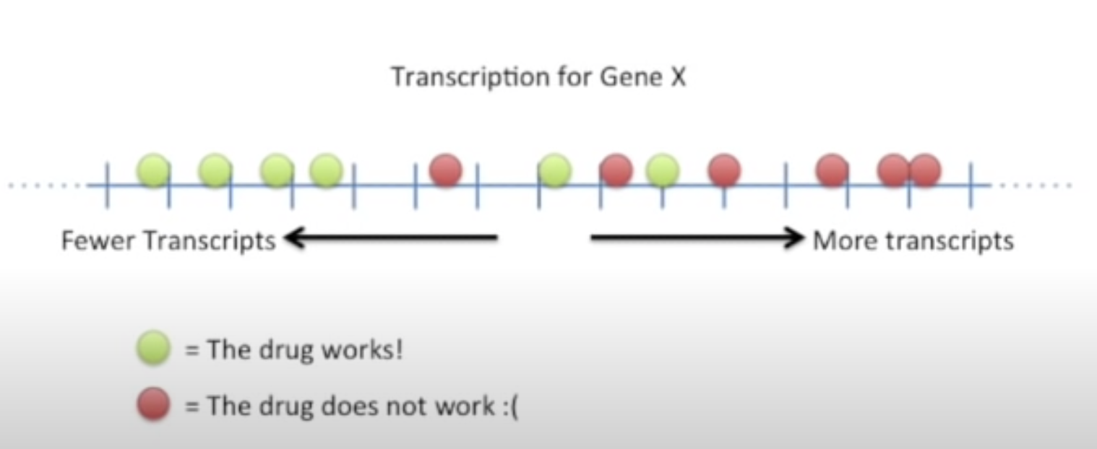
Linear Discriminant Analysis (LDA)
Let’s learn it with an example. Assume that we have a cancer drug.
  It makes some people feel much better
  However, it makes some people feel worse
How can we decide who to give this drug to?
If we use only one gene to decide...
This part is not easy to seperate

Slide 8
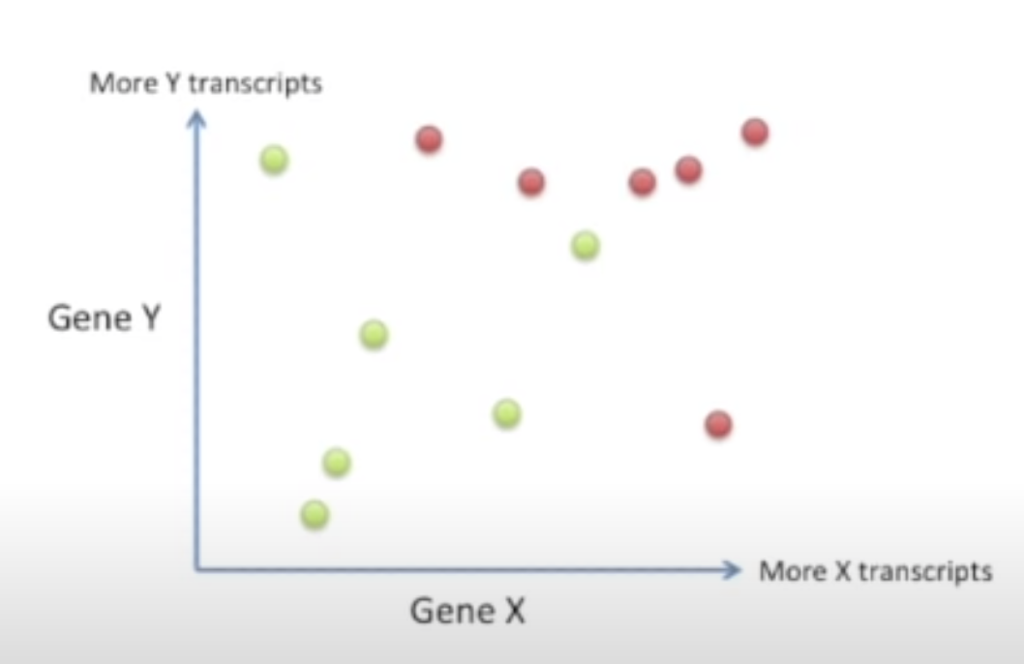
Linear Discriminant Analysis (LDA)
What if we use two genes
It’s much better but not perfect with 2 features

Slide 9
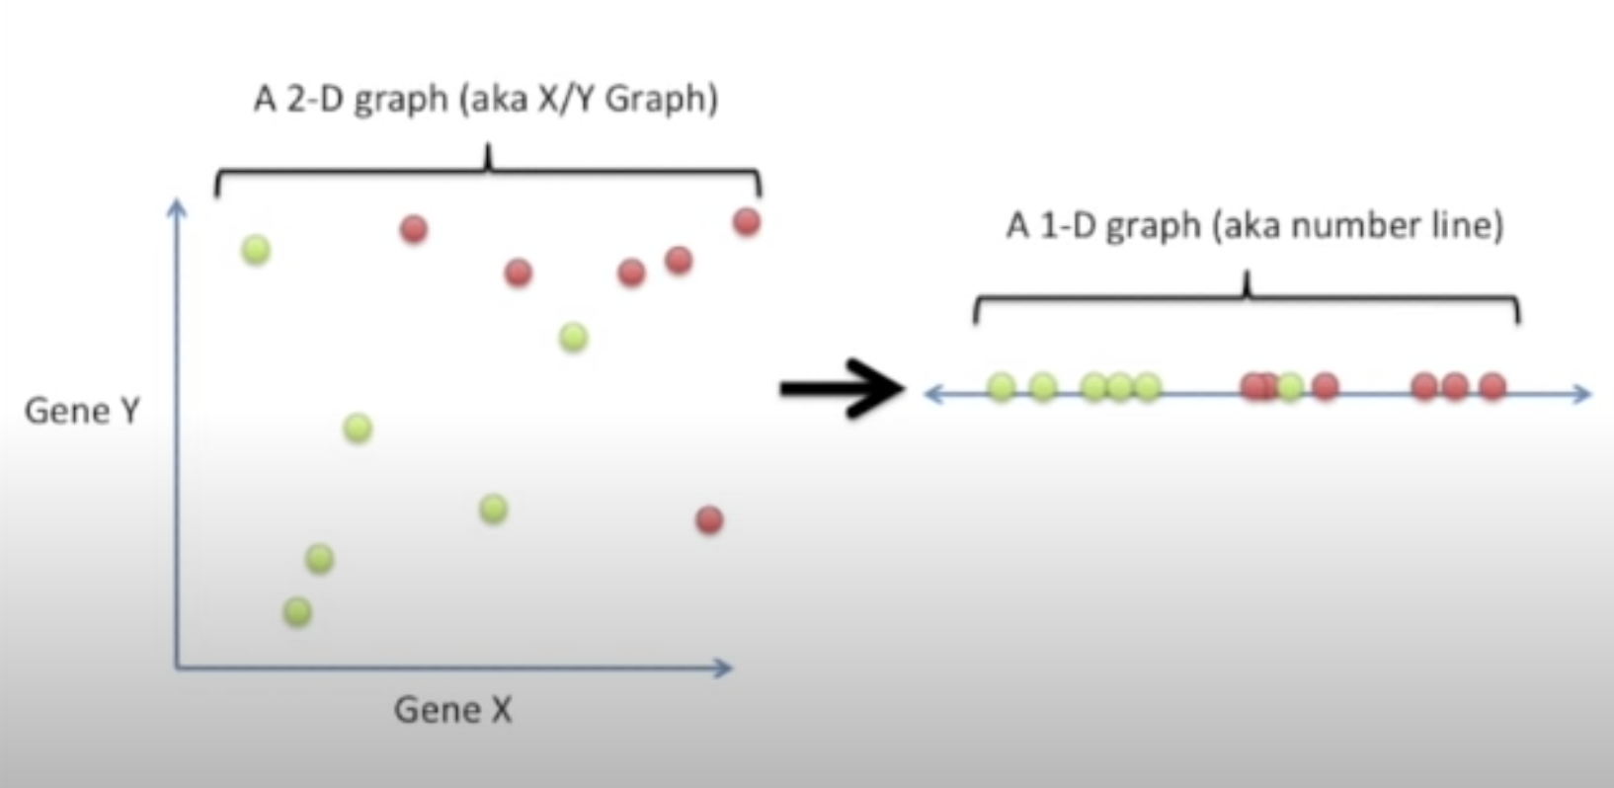
Linear Discriminant Analysis (LDA)
We want to reduce the dimension while keeping maximum class separability.
How does LDA perform this operation?

Slide 10
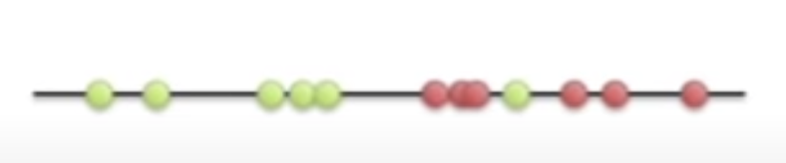
Linear Discriminant Analysis (LDA)
There are 2 criteria in LDA:
  Maximize the distance between means of both classes
  Minimize the variation (scatter) within each class
d
𝞵
𝞵
We want to maximize
d² / (s1 + s2)
s1
s2

Slide 11
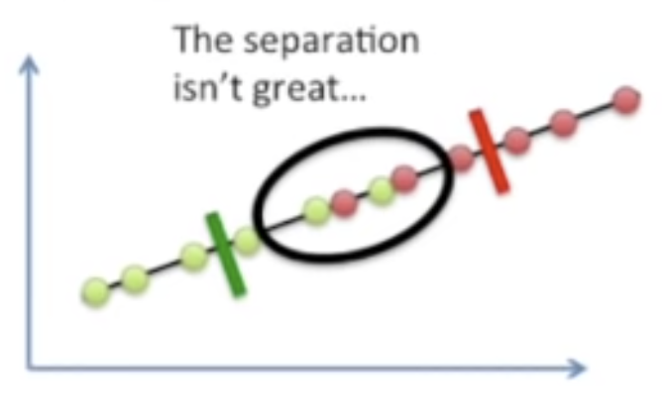
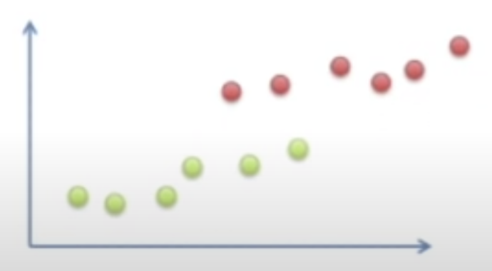
Linear Discriminant Analysis (LDA)
If we only focused to maximize mean but not minimize the scatter, then it would not be enough in some cases.

Slide 12
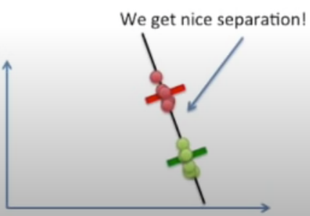
Linear Discriminant Analysis (LDA)
If we both focus to maximize mean and minimize the scatter, then...

Slide 13
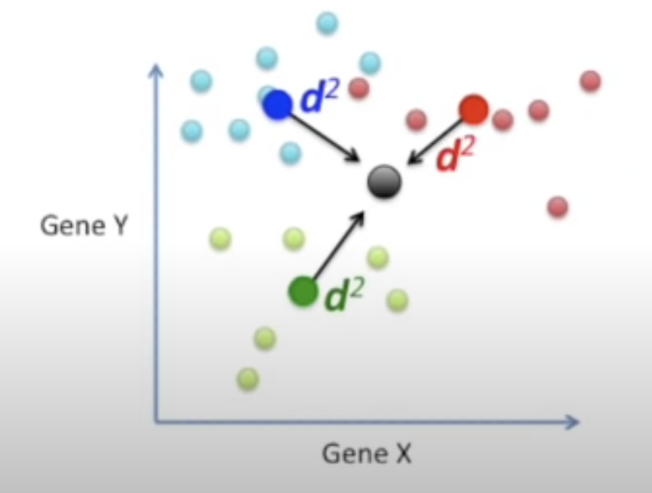
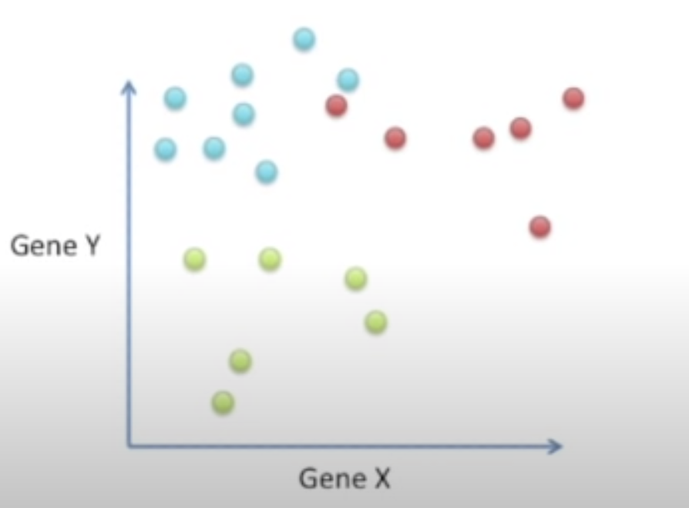
Linear Discriminant Analysis (LDA)
What about multiclass problem?
  In order to calculate d value, we should first calculate the center of the data.

Slide 14
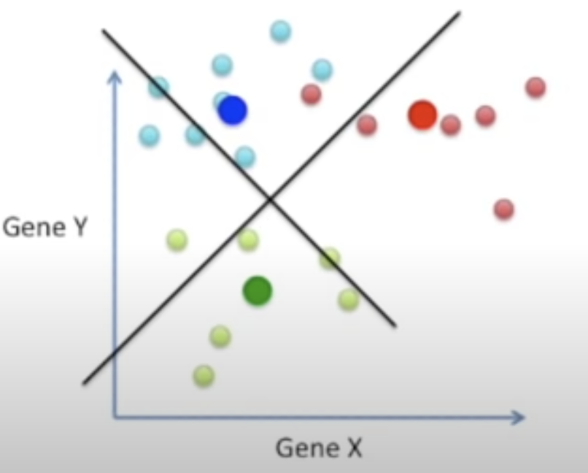
Linear Discriminant Analysis (LDA)
We will now maximize (d² + d² + d² ) / (s1 + s2 + s3)
It will compose 2 axes

Slide 15
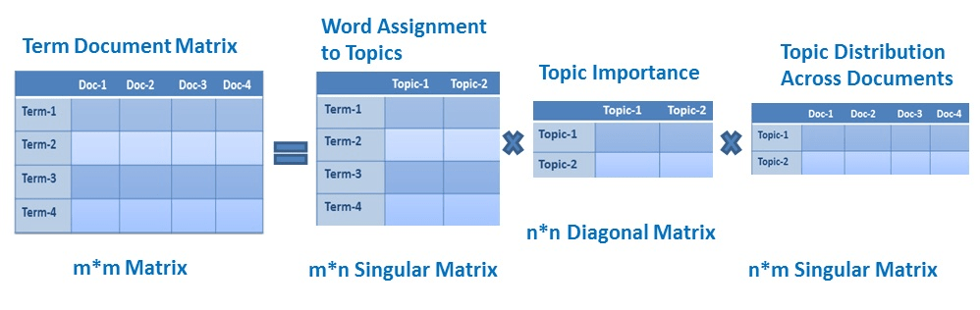
Latent Semantic Analysis (SVD)
By using SVD, we can see what's happening inside the PCA wrapper.
It can handle sparse matrices, so it’s preferred to use TruncatedSVD instead of PCA for the large datasets.
It will split your TF-IDF matrix into three matrices. The Truncated part of TruncatedSVD will discard the dimensions that contain the least information in our data.

Slide 16
Latent Semantic Analysis (SVD)
We might use cosine similarity between document-topic vectors to find similar documents. This is how semantic search works as well.
Whichever algorithm we want to use for LSA (PCA, truncated SVD, or LDiA), we need to normalize TF-IDF vectors (by default sklearn does it for us). Otherwise, you may end up with large scale differences between your topics. Scale differences between topics can reduce the ability of your model to differentiate between subtle, infrequent topics.

Slide 17
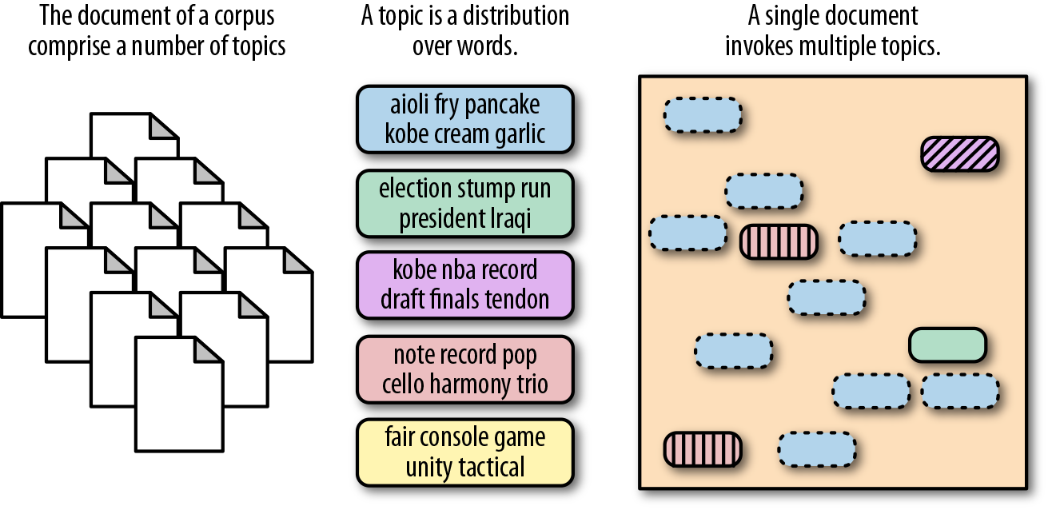
Latent Dirichlet Allocation (LDiA)
LDiA is a topic discovery technique. It belongs to the generative probabilistic model family, in which topics are represented as the probability that each of a given set of terms will occur. Documents can in turn be represented in terms of a mixture of these topics. Here is the original paper.

